Slide 1

Transaction
Computer System Engineering, Fall 2018. (IPADS, SJTU)
New Abstraction: Atomicity & Isolation
Yubin Xia

Slide 2
Transaction

Slide 3
Our Goal
Goal: build reliable systems from unreliable components
This is difficult because reasoning about failures is difficult
We need some new abstractions that will let us simplify
Atomicity
Isolation

Slide 4
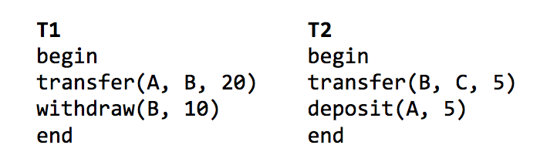
Transactions: Provide Atomicity and Isolation
Atomicity: T1 and T2 will each appear to have run to completion, or not at all
Isolation: when run concurrently, it will appear as if T1 and T2 were run sequentially (serially)
These two abstractions make it easier to reason about failures (and concurrency)

Slide 5
Atomicity: All-or-Nothing
An action is atomic if happens completely or not at all
If guarantee atomicity, it will be much easier to reason about failures
Need to think about the consequences of the action happening or not happening, but not about the action partially happening

Slide 6
Example: the IBM System/370
Multi-operand character-editing instruction
TRANSLATE contains 3 arguments
Two addresses: string and table, 8-bit counter: length
Takes 1 byte at a time from string, as an offset in table, get the byte in table, then replace the byte in string
Problem: page fault
Solution: dry run
Hidden copy of register make no change to memory
Maybe several dry run for one instruction, then run it again
Problem again: what if another process snatch a page?

Slide 7
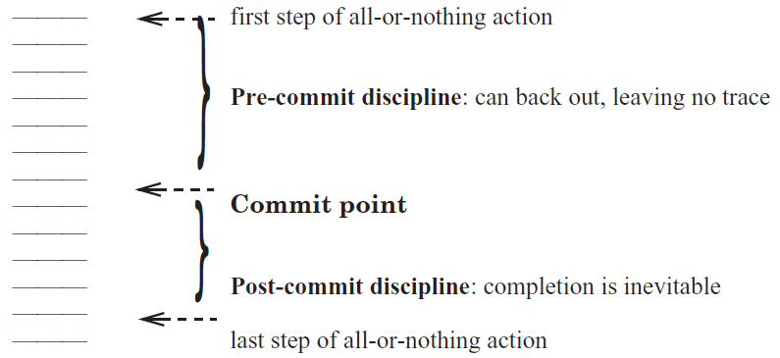
Commit Point

Slide 8
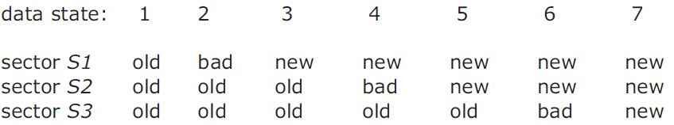
Commit Point
Where is the commit point?

Slide 9
Shadow Copy

Slide 10
Bank Account Transfer
audit(bank):
xfer(bank, a, b, amt):
bank[a] = bank[a] – amt
bank[b] = bank[b] + amt
audit(bank):
sum = 0
for acct in bank:
sum = sum + bank[acct]
return sum
<- sum=200
<- sum=150
<- sum=200
Notes:
Demo: stresses inconsistent behavior due to concurrency (i.e., audit)

Slide 11
Shadow Copy
xfer(bank, a, b, amt):
bank[a] = read_accounts(bankfile)
bank[a] = bank[a] – amt
bank[b] = bank[b] + amt
write_accounts(#bankfile)
rename("#bankfile", bankfile)
Notes:
Idea: write to a shadow copy of the file first, then rename file in one step.
[ slide: file xfer with shadow ]
Here, we assume rename() will replace existing bankfile with "newfile".
If system crashes before rename, bank contains old balances.
If system crashes after rename, bank contains new balances.
Of course, we need to ensure that only one operation runs at a time,
but we will talk about concurrency later.
We call the rename a "commit point".
Commit point: crash before gives old value, crash after gives new value.
Commit point must be itself an all-or-nothing action.
Need rename (our commit point) to have all-or-nothing atomicity..

Slide 12
rename("#bank", "bank")
Directory data blocks:
filename "bank" → inode 12
filename "#bank" → inode 13
inode 12:
data blocks: 3, 4, 5
refcount: 1
inode 13:
data blocks: 6, 7, 8
refcount: 1
Notes:
If crash, then refcount is wrong.

Slide 13
rename("#bank", "bank")
Directory data blocks:
filename "bank" → inode 13
filename "#bank" → inode 13
inode 12:
data blocks: 3, 4, 5
refcount: 1
inode 13:
data blocks: 6, 7, 8
refcount: 1
Notes:
If crash, then refcount is wrong.

Slide 14
rename("#bank", "bank")
Directory data blocks:
filename "bank" → inode 13
filename "#bank" → inode 13
inode 12:
data blocks: 3, 4, 5
refcount: 1
inode 13:
data blocks: 6, 7, 8
refcount: 2

Slide 15
rename("#bank", "bank")
Directory data blocks:
filename "bank" → inode 13
filename "#bank" → inode 13
inode 12:
data blocks: 3, 4, 5
refcount: 0
inode 13:
data blocks: 6, 7, 8
refcount: 2

Slide 16
rename("#bank", "bank")
Directory data blocks:
filename "bank" → inode 13
filename "#bank" → inode 13
inode 12:
data blocks: 3, 4, 5
refcount: 0
inode 13:
data blocks: 6, 7, 8
refcount: 2

Slide 17
rename("#bank", "bank")
Directory data blocks:
filename "bank" → inode 13
filename "#bank" → inode 13
inode 12:
data blocks: 3, 4, 5
refcount: 0
inode 13:
data blocks: 6, 7, 8
refcount: 1

Slide 18
Problem
Q: If crash, in what step will cause problem?
Two names point fnew's inode, but refcount is 1
Problem: which reference is the correct one?

Slide 19
Second Try: Increase ref-count First
rename(x, y):
newino = lookup(x)
oldino = lookup(y)
incref(newino)
change y's dirent to newino
decref(oldino)
remove x's dirent
decref(newino)
Notes:
We never have too few refcounts, but still might have too many.

Slide 20
rename("#bank", "bank")
Directory data blocks:
filename "bank" → inode 12
filename "#bank" → inode 13
inode 12:
data blocks: 3, 4, 5
refcount: 1
inode 13:
data blocks: 6, 7, 8
refcount: 2

Slide 21
rename("#bank", "bank")
Directory data blocks:
filename "bank" → inode 13
filename "#bank" → inode 13
inode 12:
data blocks: 3, 4, 5
refcount: 1
inode 13:
data blocks: 6, 7, 8
refcount: 2

Slide 22
rename("#bank", "bank")
Directory data blocks:
filename "bank" → inode 13
filename "#bank" → inode 13
inode 12:
data blocks: 3, 4, 5
refcount: 0
inode 13:
data blocks: 6, 7, 8
refcount: 2

Slide 23
rename("#bank", "bank")
Directory data blocks:
filename "bank" → inode 13
filename "#bank" → inode 13
inode 12:
data blocks: 3, 4, 5
refcount: 0
inode 13:
data blocks: 6, 7, 8
refcount: 2

Slide 24
rename("#bank", "bank")
Directory data blocks:
filename "bank" → inode 13
filename "#bank" → inode 13
inode 12:
data blocks: 3, 4, 5
refcount: 0
inode 13:
data blocks: 6, 7, 8
refcount: 1
Q: where is the commit point?
Notes:
Q: What's the commit point? Modifying y's dirent.
Q: What if we crash during the commit point writing to the dirent?
Assume that writing to one sector on disk is all-or-nothing.
An ideal disk saves enough energy to complete one sector write.
Time spent writing a sector is small (remember, high sequential speed).
Small capacitor suffices to power disk for a few microseconds.
If write didn't start, no need to complete it: still all-or-nothing.

Slide 25
Recovery After Crash
salvage(disk):
for inode in disk.inodes:
inode.refcnt =
find_all_refs(disk.root_dir, inode)
if exists("#bank"):
unlink(“#bank”)
Notes:
Fixing up after a crash: salvage.
If we crash, our commit point ensures we have all-or-nothing atomicity.
But we still have a bit of a mess left over because of the crash.
If we crashed before commit: extra refcount on inode 13.
If we crashed after commit: extra refcount on inode 12.
In both cases: directory entry for "newfile" can be removed.
[ slide: salvage function ]

Slide 26
Shadow Copy
Write to a copy of data, atomically switch to new copy
Switching can be done with one all-or-nothing operation (sector write)
Requires a small amount of all-or-nothing atomicity from lower layer (disk)
Main rule: only make one write to current/live copy of data
In our example, sector write for rename
Creates a well-defined commit point

Slide 27
Shadow Copy
Does the shadow copy approach work in general?
+ Works well for a single file
- Hard to generalize to multiple files or directories
Might have to place all files in a single directory, or rename subdirs
- Requires copying the entire file for any (small) change
- Only one operation can happen at a time
- Only works for operations that happen on a single computer, single disk

Slide 28
Logging for All-or-nothing

Slide 29
Goal: Build Reliable Systems from Unreliable Components
The abstraction that makes that easier is transactions, which provide atomicity and isolation, while not hindering performance
shadow copies (simple, poor performance)
Other ways?
atomicity
isolation
eventually, we also want transaction-based systems to be distributed: to run across multiple machines

Slide 30
Example: Bank Account App (Shadow Copy)
xfer(bank, a, b, amt):
copy(bank, tmp)
tmp[a] = tmp[a] – amt
tmp[b] = tmp[b] + amt
rename(tmp, bank)

Slide 31
Transaction Terminology
xfer(bank, a, b, amt):
begin
bank[a] = bank[a] – amt
bank[b] = bank[b] + amt
if bank[a] < 0:
abort //Not enough funds
else:
commit
xfer(bank, a, b, amt):
begin
write (a, read(a) – amt)
write (b, read(b) – amt)
if read (a) < 0:
abort //Not enough funds
else:
commit
Notes:
not everything can be a transaction.

Slide 32
Consider the Bank Account Example
Two accounts: A and B
Accounts start out empty
Run these all-or-nothing actions
Problem
After crash, A=110, but T3 never committed
Solution
Revert to A's previous committed value
T1 and T2: "All"
T3: "Nothing"
begin // T1
A = 100
B = 50
"commit // A=100; B=50
begin // T2
A = A - 20
B = B + 20
"commit // A=80; B=70
begin // T3
A = A + 30 // A=110
--CRASH--
Notes:
Logging: only record the delta.

Slide 33
A Log Sample
+-------+------+--------+-------+------+--------+-------+
TID | T1 | T1 | T1 | T2 | T2 | T2 | T3 |
OLD | A=0 | B=0 | | A=100 | B=50 | | A=80 |
NEW | A=100 | B=50 | COMMIT | A=80 | B=70 | COMMIT | A=110 |
+-------+------+--------+-------+------+--------+-------+
begin // T1
A = 100
B = 50
"commit // A=100; B=50
begin // T2
A = A - 20
B = B + 20
"commit // A=80; B=70
begin // T3
A = A + 30 // A=110
--CRASH--

Slide 34
Five Operations Involved
Begin
Write variable
Read variable
Commit
Abort

Slide 35
Five Operations Involved
1. begin: allocate a new transaction ID
2. write variable: append an entry to the log
3. read variable: scan the log looking for last committed value
As an aside: how to see your own updates?
Read uncommitted values from your own TID

Slide 36
Read
+-------+------+--------+-------+------+--------+-------+
TID | T1 | T1 | T1 | T2 | T2 | T2 | T3 |
OLD | A=0 | B=0 | | A=100 | B=50 | | A=80 |
NEW | A=100 | B=50 | COMMIT | A=80 | B=70 | COMMIT | A=110 |
+-------+------+--------+-------+------+--------+-------+
read(log, var):
commits = {}
// scan backwards
for record r in log[len(log) - 1] .. log[0]:
// keep track of commits
if r.type == commit:
commits.add(r.tid)
// find var's last committed value
if r.type == update and
r.tid in commits and
r.var == var:
return r.new_value
Notes:
Q: Which is a commit point?
Assumption: writing a single disk block is atomic. A partially written record is ignored.

Slide 37
Read
+-------+------+--------+-------+------+--------+-------+
TID | T1 | T1 | T1 | T2 | T2 | T2 | T3 |
OLD | A=0 | B=0 | | A=100 | B=50 | | A=80 |
NEW | A=100 | B=50 | COMMIT | A=80 | B=70 | COMMIT | A=110 |
+-------+------+--------+-------+------+--------+-------+
read(log, var):
commits = {}
// scan backwards
for record r in log[len(log) - 1] .. log[0]:
// keep track of commits
if r.type == commit:
commits.add(r.tid)
// find var's last committed value
if r.type == update and
（r.tid in commits or r.tid == current_tid) and
r.var == var:
return r.new_value
Notes:
Q: Which is a commit point?
Assumption: writing a single disk block is atomic. A partially written record is ignored.

Slide 38
Five Operations Involved
4. Commit: write a commit record
Expectedly, writing a commit record is the "commit point" for action, because of the way read works (looks for commit record)
However, writing log records better be all-or-nothing
One approach, from last time: make each record fit within one sector
5. Abort: Do nothing or write a record?
Could write an abort record, but not strictly needed
Recover from a crash: do nothing

Slide 39
Performance Problem of Log-only Approach
Write performance is probably good
Sequential writes, instead of random
Need to write to disk twice instead of once (old and new)
Read performance is terrible!
Scan the log for every read!
Recovery is instantaneous
Nothing to do

Slide 40
Performance Optimization
Keep both a log and cell storage
Log as before: authoritative, provides all-or-nothing atomicity
Cell storage: provides fast reads, but cannot provide all-or-nothing
Both are stored on disk
Terminology
"log" an update when it's written to the log
"install" an update when it's written to cell storage
Notes:
[ board: log, cell storage; updates going to both, read from cell storage ]

Slide 41
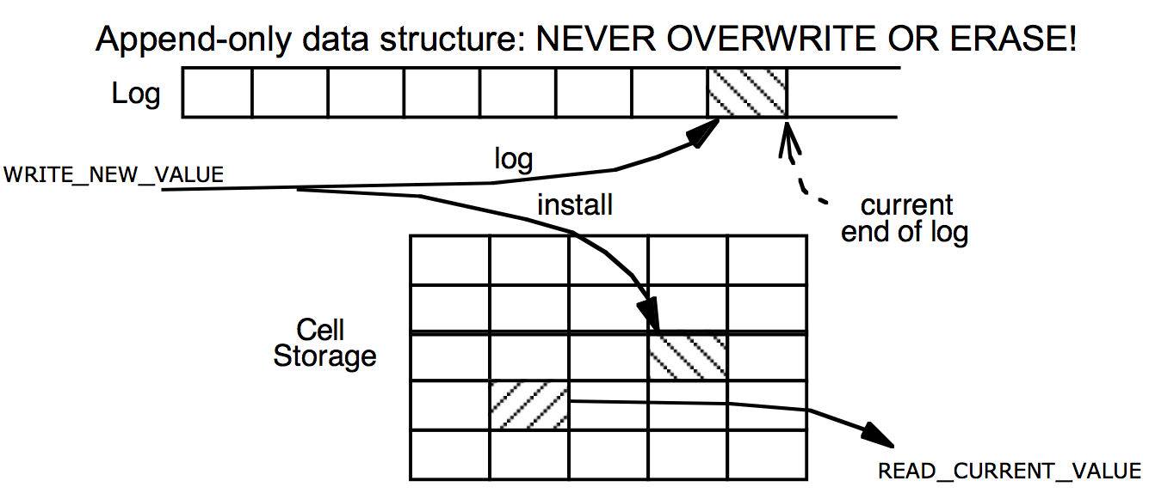
Cell Storage (Home) + Log Storage

Slide 42
Read / write with Cell Storage
Two questions we have to answer now:
How to update both the log and cell storage when an update happens?
How to recover cell storage from the authoritative log after crash?

Slide 43
Read / write with Cell Storage
+-------+------+--------+-------+------+--------+-------+
TID | T1 | T1 | T1 | T2 | T2 | T2 | T3 |
OLD | A=0 | B=0 | | A=100 | B=50 | | A=80 |
NEW | A=100 | B=50 | COMMIT | A=80 | B=70 | COMMIT | A=110 |
+-------+------+--------+-------+------+--------+-------+
Cell Storage
A 110
B 70
read(var):
return cell_read(var)
write(var, value):
log.append(cur_tid, update, var, read(var), value)
cell_write(var, value)
Notes:
Recovery? Crash between logging and installing.
Write is not all-or-nothing! install value before commit? what if crash? Need to roll back to old value (which is saved in the log)
Log still contains the same things.
As we're running, maintain cell storage for A and B.
Except one problem: after crash, A's value in cell storage is wrong.
Last action aborted (due to crash), but its changes to A are visible.
We're going to have to repair this in our recovery function.
Good thing we have the log to provide authoritative information.

Slide 44
Order Matters
Ordering of logging and installing
The two together do not have all-or-nothing atomicity
Can crash in-between, so just one of the two might have taken place
What happens if we install first and then log?
If we crash, no idea what happened to cell storage, or how to fix it
The rule for logging is the "Write-ahead-log protocol" (WAL)
Log the update before installing it
If we crash, log is authoritative and intact, can repair cell storage
Can think of it as not being the only copy, once it's in the log

Slide 45
Recovering Cell Storage
What happens if we log an update, install it, but then abort/crash?
Need to undo that installed update
Plan: scan log, determine what actions aborted ("losers"), undo them
Why do we have to scan backwards?
Need to undo newest to oldest
Also need to find outcome of action before we decide whether to undo

Slide 46
Recovery with Cell Storage
+-------+------+--------+-------+------+--------+-------+
TID | T1 | T1 | T1 | T2 | T2 | T2 | T3 |
OLD | A=0 | B=0 | | A=100 | B=50 | | A=80 |
NEW | A=100 | B=50 | COMMIT | A=80 | B=70 | COMMIT | A=110 |
+-------+------+--------+-------+------+--------+-------+
Cell Storage
A 110
B 70
commits = {}
recover(log):
commits = {}
for record r in log[len(log)-1] .. log[0]:
if r.type == commit:
commits.add(r.tid)
if r.type == update and r.tid not in commits:
cell_write(r.var, r.old_val) // undo
Notes:
Recovery? Crash between logging and installing.
Write is not all-or-nothing! install value before commit? what if crash? Need to roll back to old value (which is saved in the log)
Log still contains the same things.
As we're running, maintain cell storage for A and B.
Except one problem: after crash, A's value in cell storage is wrong.
Last action aborted (due to crash), but its changes to A are visible.
We're going to have to repair this in our recovery function.
Good thing we have the log to provide authoritative information.

Slide 47
Recovery with Cell Storage
+-------+------+--------+-------+------+--------+-------+
TID | T1 | T1 | T1 | T2 | T2 | T2 | T3 |
OLD | A=0 | B=0 | | A=100 | B=50 | | A=80 |
NEW | A=100 | B=50 | COMMIT | A=80 | B=70 | COMMIT | A=110 |
+-------+------+--------+-------+------+--------+-------+
Cell Storage
A 80
B 70
commits = {}
recover(log):
commits = {}
for record r in log[len(log)-1] .. log[0]:
if r.type == commit:
commits.add(r.tid)
if r.type == update and r.tid not in commits:
cell_write(r.var, r.old_val) // undo
Notes:
Recovery? Crash between logging and installing.
Write is not all-or-nothing! install value before commit? what if crash? Need to roll back to old value (which is saved in the log)
Log still contains the same things.
As we're running, maintain cell storage for A and B.
Except one problem: after crash, A's value in cell storage is wrong.
Last action aborted (due to crash), but its changes to A are visible.
We're going to have to repair this in our recovery function.
Good thing we have the log to provide authoritative information.

Slide 48
Recovery with Cell Storage
+-------+------+--------+-------+------+--------+-------+
TID | T1 | T1 | T1 | T2 | T2 | T2 | T3 |
OLD | A=0 | B=0 | | A=100 | B=50 | | A=80 |
NEW | A=100 | B=50 | COMMIT | A=80 | B=70 | COMMIT | A=110 |
+-------+------+--------+-------+------+--------+-------+
Cell Storage
A 80
B 70
commits = {T2}
recover(log):
commits = {}
for record r in log[len(log)-1] .. log[0]:
if r.type == commit:
commits.add(r.tid)
if r.type == update and r.tid not in commits:
cell_write(r.var, r.old_val) // undo

Slide 49
Recovery with Cell Storage
+-------+------+--------+-------+------+--------+-------+
TID | T1 | T1 | T1 | T2 | T2 | T2 | T3 |
OLD | A=0 | B=0 | | A=100 | B=50 | | A=80 |
NEW | A=100 | B=50 | COMMIT | A=80 | B=70 | COMMIT | A=110 |
+-------+------+--------+-------+------+--------+-------+
Cell Storage
A 80
B 70
commits = {T2, T1}
recover(log):
commits = {}
for record r in log[len(log)-1] .. log[0]:
if r.type == commit:
commits.add(r.tid)
if r.type == update and r.tid not in commits:
cell_write(r.var, r.old_val) // undo

Slide 50
Performance Now
Writes might still be OK
But we do write two places: log & install
Reads are fast
Just look up in cell storage
Recovery requires scanning the entire log
Remaining performance problems:
We have to write to disk twice
Scanning the log will take longer and longer, as the log grows

Slide 51
Optimization 1: Improve Writes
Storing installing in a (volatile) cache, e.g., memory
Writes can now be fast: just one write, instead of two
Hope that variable is modified several times in cache before flush
Reads can also be benefited
Reads go through the cache, since cache may contain more up-to-date values

Slide 52
Read & Write with Cache
+-------+------+--------+-------+------+--------+-------+
TID | T1 | T1 | T1 | T2 | T2 | T2 | T3 |
OLD | A=0 | B=0 | | A=100 | B=50 | | A=80 |
NEW | A=100 | B=50 | COMMIT | A=80 | B=70 | COMMIT | A=110 |
+-------+------+--------+-------+------+--------+-------+
Cell Storage
A 110
B 70
Cache
A 110
B 70
read(var):
if var in cache:
return cache[var]
else: // may evict others from cache to cell storage
cache[var] = cell_read(var)
return cache[var]
write(var, value):
log.append(current_tid, update, var, read(var), value)
cache[var] = value

Slide 53
Problem Brought by Cache
Atomicity problem: cell storage (on disk) may be out-of-date
Is it possible to have changes that should be in cell storage, but are not?
Yes: might not have flushed the latest commits
Is it possible to have changes that should not be in cell storage, but are?
Yes: flushed some changes that then aborted (same as before)
Solution: change the recover procedure
Need a redo phase in addition to an undo phase in recovery
Do not treat actions with an abort record as "done"
There might be leftover changes from them in cell storage

Slide 54
Recover with Cache
+-------+------+--------+-------+------+--------+-------+
TID | T1 | T1 | T1 | T2 | T2 | T2 | T3 |
OLD | A=0 | B=0 | | A=100 | B=50 | | A=80 |
NEW | A=100 | B=50 | COMMIT | A=80 | B=70 | COMMIT | A=110 |
+-------+------+--------+-------+------+--------+-------+
Cell Storage
A 110
B 70
Cache
A 110
B 70
recover(log):
commits = {}
for record r in log[len(log)-1] .. log[0]:
if r.type == commit:
commits.add(r.tid)
if r.type == update and r.tid not in commits:
cell_write(r.var, r.old_val) // undo
for record r in log[0] .. log[len(log)-1]:
if r.type == update and r.tid in commits:
cell_write(r.var, r.new_value) // redo

Slide 55
Optimization 2: Truncate the Log
Current log grows without bound: not practical
What part of the log can be discarded?
Must know the outcome of every action in that part of log
Cell storage must reflect all of those log records (commits, aborts).
Truncating mechanism (assuming no pending actions):
Flush all cached updates to cell storage
Write a checkpoint record, to save our place in the log
Truncate log prior to checkpoint record
(Often log implemented as a series of files, so can delete old log files)
With pending actions, delete before checkpoint & earliest undecided record

Slide 56
Checkpointing
Doing the following:
1. Stop accepting new transactions
2. Wait until all current transactions commit or abort and have written the COMMIT or ABORT to the log
3. Flush the log to disk
4. Write a log record <CKPT> and flush the log again
5. Resume accepting transactions
No need to look in the log file prior to the last checkpoint

Slide 57
Non-quiescent Checkpointing
The problem with checkpointing:
Need to stop the system until all current operations have committed or aborted
Non-quiescent checkpointing:
1. Write a record <START CKPT(T1…Tk)> and flush log (T1,…Tk are the active transactions)
2. Wait until all of T1, … Tk commit or abort, but allow new transactions to start
3. When all of T1,…Tk have written COMMIT or ABORT, then write <END CKPT> to the log

Slide 58
Non-quiescent Checkpointing
If crash, then look backwards for the first <START CKPT(T1…Tk)> or <END CKPT>
If see an <END CKPT>, only have to consider after this
If see a <START CKPT(T1…Tk)> but no <END CKPT>, then only need to consider after the transactions T1, .. Tk began

Slide 59
Optimization-3: External Synchronous I/O
Problem: flush to disk is slow
Lazy writing, even for the log file
Some app, e.g., database, calls sync() to ensure flushing
But sync() is slow…
Solution: External Sync
Once the kernel return from sync(), the file may not be flushed
It will be flushed if something externally visible happens
E.g., print to the user, network sending, serial port outcome, etc.
"Rethink the Sync", OSDI 2004

